Slide 1
Types of Software (Programs)
Computers are very powerful pieces of hardware that can’t do much useful work until they are properly programmed
There are three different types of software:
Operating Systems
Application Programs
Software Development Tools (or Kits)
As a computer programmer, you may need to use and/or write any or all three types of programs

Slide 2
Operating System Programs
“O/S” programs control the hardware and allow application programs to be executed
An O/S is usually built to run on a specific underlying hardware platform, e.g. PC, MAC, or server
Generally these are the most complex types of programs to write and test
Examples:
M/S DOS, Windows, UNIX, Linux, Solaris, etc.

Slide 3
Application Programs
“Apps” perform useful work for their users
Apps are usually built to run on a specific operating system (and maybe a specific underlying hardware platform)
Users typically need to provide a lot of information about their job tasks for a programmer to write a good application program for that purpose
Examples:
Word, Excel, PowerPoint, Chrome, etc.

Slide 4
Software Development Tools
Software Development Tools or Kits (SDK’s) are specialized application programs that allow programmers to write and test programs
Experienced programmers generally prefer an “Integrated Development Environment” (IDE)
Examples (that we’ll be using in this course):
Sun’s Java SDK (sometimes called JDK)
Dr Java IDE

Slide 5
Styles of User Interface
There are two predominant styles of User Interface for any type of program:
Command Line Interface (CLI)
Graphical User Interface (GUI)
As a computer programmer, you must be able to use and/or write programs for both styles of user interface

Slide 6
Styles of User Interface
Command Line Interface (CLI)
Computer types a “Prompt” requesting input
User types a “Command” with “Parameters”
Predominantly an old style of interaction that does not require a lot of computer power, but still in use today in some O/S and applications
Considered to be NOT “user friendly”, but is very efficient when combined with “scripting”
Example: DOS prompt, command & parameter
C:\ >type file.txt (display the contents of the file)

Slide 7
Styles of User Interface
Graphical User Interface (GUI)
Computer displays a combination of text and graphical symbols offering options to the user
User manipulates mouse and uses keyboard to select from the offered options (“hot keys”) or to enter text
More common now (computer power is cheap)
Considered by most to be “user friendly”
Examples: M/S Windows/Office or MAC O/S

Slide 8
Software Development Tools
Using Sun Java SDK alone
Command Line Interface
Editor
Programmer
Source
File(s)
(.java)
Class
File(s)
(.class)
Virtual
Machine
(java)
Compiler
(javac)
Program
executes
Parts of Sun Java SDK

Slide 9
Using Sun Java SDK Alone
Example DOS Commands and Parameters
C:\ > edit HelloWorld.java
(Create/edit “source file” in an external window)
C:\ > javac HelloWorld.java (creates .class file)
C:\ > java -classpath … HelloWorld
Hello World
C:\ > exit

Slide 10
Software Development Tools
We will use a combination of the netbeans, eclipse, Jcreator Dr Java IDE and the Sun Java SDK
Graphical User Interface
Dr Java IDE
Edit
Build
Run
Programmer
Source
File(s)
(.java)
Class
File(s)
(.class)
Virtual
Machine
(java)
Compiler
(javac)
Program
executes
Parts of Sun Java SDK

Slide 11
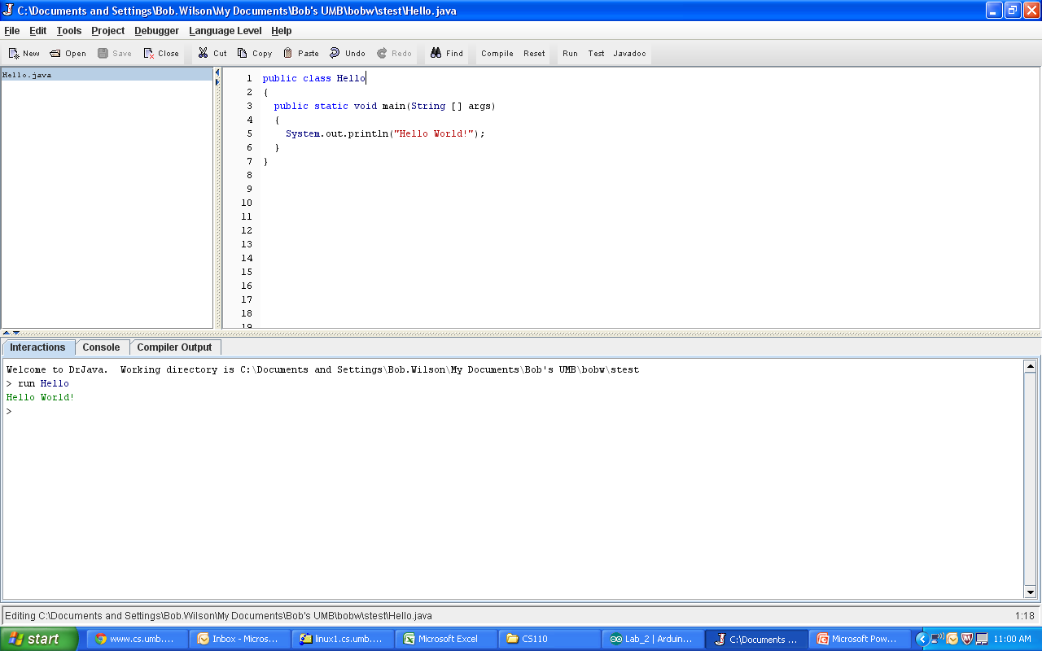
On-line Demonstration

Slide 12
Program Development Steps
Classical “Waterfall” Development Steps
Edit and save
source code
Build source code
to create program
Errors
Run program and
evaluate results
Errors

Slide 13
Errors
A program can have three types of errors:
The IDE editor and/or compiler will find syntax errors and other basic problems (compile-time errors)
If compile-time errors exist, an executable version of the program is not created
A problem can occur during program execution, such as trying to divide by zero, which causes a program to terminate abnormally (run-time errors)
A program may run, but produce incorrect results, perhaps using an incorrect formula (logical errors)

Slide 14
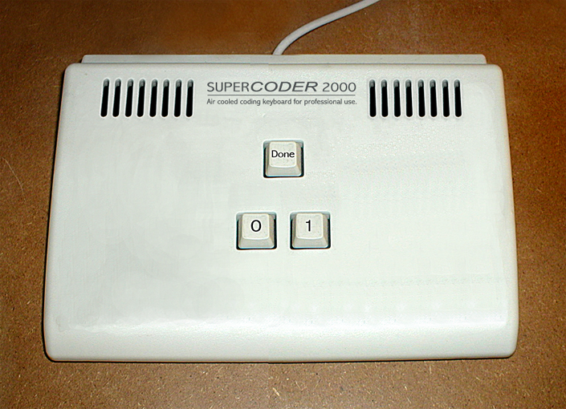
A bit of humor: Input methods

Slide 15
Translation
Translator
Accepts a program written in a source language and translates it to a program in a target language
Compiler
Standard name for a translator whose source language is a high-level language
Interpreter
A translator that both translates and executes a source program
Notes:
The commands in a high-level language program are not executed directly by a computer. A high-level language program has to be translated first. The conversion is accomplished by a specialized program called a translator. A translator accepts a program written in a one language and translates it to an equivalent program in another language. The input to the translator is the source program and the output of the translator is the target program. Most translators convert a high-level language program to a machine language program. For high-level languages, a translator normally is referred to as a compiler.
A particular type of translator of interest to Java programmers is an interpreter. An interpreter is a translator that both translates and executes the source program.

Slide 16
Java translation
Two-step process
First step
Translation from Java to bytecodes
Bytecodes are architecturally neutral object code
Bytecodes are stored in a file with extension .class
Second step
An interpreter translates the bytecodes into machine instructions and executes them
Interpreter is known a Java Virtual Machine or JVM
Notes:
At the beginning of this section, we mentioned that one of the key features of Java is that a Java program can run on a variety of different types of machines. This feature makes Java ideal for developing Internet applications where there are many different types of machines connected to the network. It is the Java interpreter that makes this happen.
When we compile a Java program, the Java compiler does not produce a machine language program for a particular computer like the compilers for other programming languages such as C, C++, or FORTRAN do. Rather the Java compiler produces a program for an interpreter called the Java Virtual Machine (JVM). Essentially, the JVM is a program that mimics the operation of a real machine. The JVM reads the program produced by the Java compiler and executes the Java machine language instructions produced by the Java compiler. The Java machine language instructions are called Java bytecodes and can be viewed as architecturally neutral object code. The bytecodes are stored in a file with an extension of .class. For program DisplayForecast.java, a Java compiler produces a bytecode file named DisplayForecast.class.

Slide 17
Software
Program
Sequence of instruction that tells a computer what to do
Execution
Performing the instruction sequence
Programming language
Language for writing instructions to a computer
Major flavors
Machine language or object code
Assembly language
High-level
Program to which computer can respond directly. Each instruction is a binary code that corresponds to a native instruction
Notes:
The instruction set for a machine is a set of binary codes that are unique to its CPU type. Consequently, different computers use different machine languages. The machine language understood by Intel’s Pentium processor is quite different from the machine language understood by IBM’s PowerPC® processor.
A major problem with machine language programming is that it is very tedious and error prone to write directly in binary codes. Slightly less tedious is assembly language programming. An assembly language is a symbolic language for coding machine language instructions. Like machine language programmers, assembly language programmers must have a complete understanding of basic operations of the machine. Furthermore, because the corresponding machine operations are so primitive, for even very simple tasks, assembly language programs can be quite long and complicated.

Slide 18
Software
Program
Sequence of instruction that tells a computer what to do
Execution
Performing the instruction sequence
Programming language
Language for writing instructions to a computer
Major flavors
Machine language or object code
Assembly language
High-level
Symbolic language for coding machine language instructions
Notes:
The instruction set for a machine is a set of binary codes that are unique to its CPU type. Consequently, different computers use different machine languages. The machine language understood by Intel’s Pentium processor is quite different from the machine language understood by IBM’s PowerPC® processor.
A major problem with machine language programming is that it is very tedious and error prone to write directly in binary codes. Slightly less tedious is assembly language programming. An assembly language is a symbolic language for coding machine language instructions. Like machine language programmers, assembly language programmers must have a complete understanding of basic operations of the machine. Furthermore, because the corresponding machine operations are so primitive, for even very simple tasks, assembly language programs can be quite long and complicated.

Slide 19
Software
Program
Sequence of instruction that tells a computer what to do
Execution
Performing the instruction sequence
Programming language
Language for writing instructions to a computer
Major flavors
Machine language or object code
Assembly language
High-level
Detailed knowledge of the machine is not required. Uses a vocabulary and structure closer to the problem being solved
Notes:
A distinguishing characteristic of a high-level programming language is that detailed knowledge of the machine being programmed is not required. Another characteristic is that a high-level programming language uses a vocabulary and structure that is close to the type of problem being solved. For example, the programming language FORTRAN, which is used to solve scientific and engineering problems, uses a notation that is mathematical. Indeed, the name FORTRAN is derived from the phrase formula translation. Because of the close coupling of a programming language to types of problems, there are literally hundreds of high-level programming languages.
The commands in a high-level language program are not executed directly by a computer. A high-level language program has to be translated first. The conversion is accomplished by a specialized program called a translator. A translator accepts a program written in a one language and translates it to an equivalent program in another language. The input to the translator is the source program and the output of the translator is the target program. Most translators convert a high-level language program to a machine language program. For high-level languages, a translator normally is referred to as a compiler.

Slide 20
Software
Program
Sequence of instruction that tells a computer what to do
Execution
Performing the instruction sequence
Programming language
Language for writing instructions to a computer
Major flavors
Machine language or object code
Assembly language
High-level
Java is a high-level programming language
Notes:
A distinguishing characteristic of a high-level programming language is that detailed knowledge of the machine being programmed is not required. Another characteristic is that a high-level programming language uses a vocabulary and structure that is close to the type of problem being solved. For example, the programming language FORTRAN, which is used to solve scientific and engineering problems, uses a notation that is mathematical. Indeed, the name FORTRAN is derived from the phrase formula translation. Because of the close coupling of a programming language to types of problems, there are literally hundreds of high-level programming languages.
The commands in a high-level language program are not executed directly by a computer. A high-level language program has to be translated first. The conversion is accomplished by a specialized program called a translator. A translator accepts a program written in a one language and translates it to an equivalent program in another language. The input to the translator is the source program and the output of the translator is the target program. Most translators convert a high-level language program to a machine language program. For high-level languages, a translator normally is referred to as a compiler.

Slide 21
Software
Program
Sequence of instruction that tells a computer what to do
Execution
Performing the instruction sequence
Programming language
Language for writing instructions to a computer
Major flavors
Machine language or object code
Assembly language
High-level
For program to be executed it must be translated
Notes:
A distinguishing characteristic of a high-level programming language is that detailed knowledge of the machine being programmed is not required. Another characteristic is that a high-level programming language uses a vocabulary and structure that is close to the type of problem being solved. For example, the programming language FORTRAN, which is used to solve scientific and engineering problems, uses a notation that is mathematical. Indeed, the name FORTRAN is derived from the phrase formula translation. Because of the close coupling of a programming language to types of problems, there are literally hundreds of high-level programming languages.
The commands in a high-level language program are not executed directly by a computer. A high-level language program has to be translated first. The conversion is accomplished by a specialized program called a translator. A translator accepts a program written in a one language and translates it to an equivalent program in another language. The input to the translator is the source program and the output of the translator is the target program. Most translators convert a high-level language program to a machine language program. For high-level languages, a translator normally is referred to as a compiler.

Slide 22
Translation
Translator
Accepts a program written in a source language and translates it to a program in a target language
Compiler
Standard name for a translator whose source language is a high-level language
Interpreter
A translator that both translates and executes a source program
Notes:
The commands in a high-level language program are not executed directly by a computer. A high-level language program has to be translated first. The conversion is accomplished by a specialized program called a translator. A translator accepts a program written in a one language and translates it to an equivalent program in another language. The input to the translator is the source program and the output of the translator is the target program. Most translators convert a high-level language program to a machine language program. For high-level languages, a translator normally is referred to as a compiler.
A particular type of translator of interest to Java programmers is an interpreter. An interpreter is a translator that both translates and executes the source program.

Slide 23
Java translation
Two-step process
First step
Translation from Java to bytecodes
Bytecodes are architecturally neutral object code
Bytecodes are stored in a file with extension .class
Second step
An interpreter translates the bytecodes into machine instructions and executes them
Interpreter is known a Java Virtual Machine or JVM
Notes:
At the beginning of this section, we mentioned that one of the key features of Java is that a Java program can run on a variety of different types of machines. This feature makes Java ideal for developing Internet applications where there are many different types of machines connected to the network. It is the Java interpreter that makes this happen.
When we compile a Java program, the Java compiler does not produce a machine language program for a particular computer like the compilers for other programming languages such as C, C++, or FORTRAN do. Rather the Java compiler produces a program for an interpreter called the Java Virtual Machine (JVM). Essentially, the JVM is a program that mimics the operation of a real machine. The JVM reads the program produced by the Java compiler and executes the Java machine language instructions produced by the Java compiler. The Java machine language instructions are called Java bytecodes and can be viewed as architecturally neutral object code. The bytecodes are stored in a file with an extension of .class. For program DisplayForecast.java, a Java compiler produces a bytecode file named DisplayForecast.class.

